Slide 1
Respiratory System
Dr Archna Ghildiyal
Associate Professor
Department of Physiology
KGMU

Slide 2
Lecture : 1
Contents:
Functional Anatomy/Organization
Functions -Respiratory
-Non-Respiratory

Slide 3
Learning Objectives
Organization of airways and Lungs
Weibel Lung model
Dead Space
Respiratory membrane
Functions

Slide 4
Respiratory System-includes
Conducting airways-oral & nasal cavities
Lungs
Nerves controlling Respiration
Structures to move air in & out:
Rib cage , Intercostal muscles,
Diaphragm,Abdominal muscles

Slide 5
Structure

Slide 6
Weibel Lung Model(Generation)

Slide 7
Dead Space
Anatomical-till terminal bronchiole/ conducting zone
No gas exchange
Volume of air:150ml
Physiological
Normal adult :Ratio of both dead space is 1

Slide 8
Key Features
Kultschitzky cells: neuroendocrine cells found in clusters throughout tracheobronchial tree
More in fortus than in adult
Secrete Dopamine,serrotonin
Role in bronchial carcinoid

Slide 9
Contd…
Upper & Lower airway
Lung surface area for gaseous exchange ~ 80 m²(size of Tennis court)
Lung Interstitium:Promonant cells: Fibroblast
Lung capillaries, lymphatics,
Macrophages

Slide 10
Contd…
Bronchioles:Clara cells(secretes a
component of surfactant ,helps in
epithelial regeneration after injury),
No goblet & submucosal glands

Slide 11
Respiratory Unit/Respiratory lobule
Alveolus (singular,av. diam 0.2 mm) & Alveoli (Pleural)
300 alveoli in 2 lungs
Extensive capillary network- SHEET of flowing blood

Slide 12
Respiratory Membrane

Slide 13
Respiratory Membrane
Layers:
1. Fluid lining the alveolus( contains surfactant,)
2.Alveolar Epithelium(thin epithelial cells)
3.Epithelial basement membrane
4.Thin Interstitial space
5.Capillary basement membrane
6.Capillary endothelial membrane

Slide 14
Respiratory Membrane
Total surface area : 70 sq.mts
Thickness : av 0.6 micrometer
Average diameter of Pulmonary capillaries : 5 micrometers
Total quantity of blood spread over the entire surface of lungs at a given instant : 60 –140 ml

Slide 15
Functions :Respiratory
“Provides O₂ to the tissues & removal of CO₂ ”
STEPS
1.Pulmonary Ventilation
2.Diffusion of O₂ & CO₂
3.Transport of gases
4.Regulation

Slide 16
Functions :Respiratory

Slide 17
Functions :Non Respiratory
1.Filtration
2. Immune
3.Metabolic
4.Phonation
5.Acid –Base balance

Slide 18
Filtration Function
Nostrils: removal of particles >6micrometer diam (Turbulent precipitation )
Smaller bronchioles: 1-5 micrometer settle(gravitational precipitation)
Alveoli :<1micromt adhere to alveolar fluid
<0.5micromt in alveolar air(in Expiration goes out)

Slide 19
Immune Function
Phagocytosis:
Tissue macrophages in alveolar
Wall
Alveolar macrophages
Lung Lymphatics
Nondigestible particle:Giant cell capsule

Slide 20
Metabolic Function
Endothelial cells of alveolar capillary beds:
Metabolize metabolic & vasoactive substances
Endothelial cells metabolize Serrotonin
Conversion of Angiotensin I to Angiotensin II(ACE present on the surface of endothelial cells)
Synthesis & Secretion of cytokines,Prostaglandins,nitric oxide etc

Slide 21
Vocalization & Phonation
Phonation
Articulation
Resonance

Slide 22
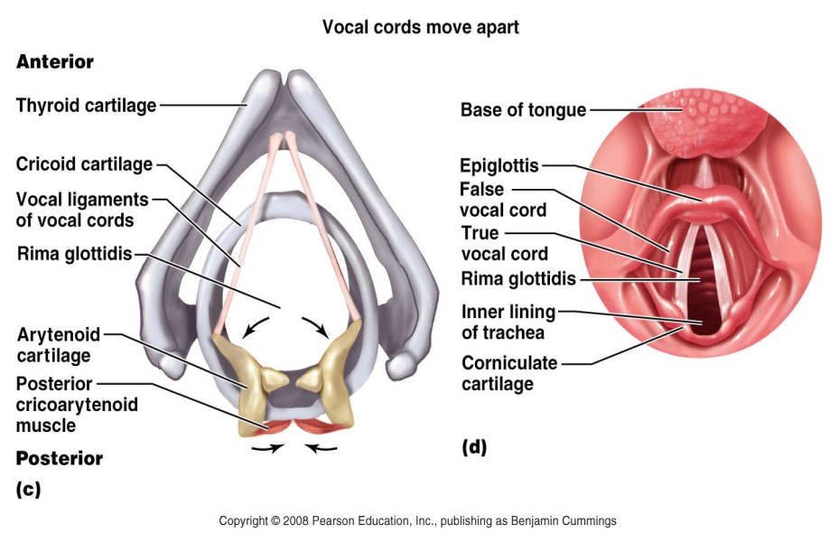
Phonation

Slide 23
Speech involves:
Speech centers in cerebral cortex
Respiratory control centers
Articulation & resonance structures of mouth & nasal cavities
Mechanical events:
-Phonation(larynx as vibrator ie.Vocal folds)
- Articulation(structures of mouth)
- Resonance(change in voice quality)

Slide 24
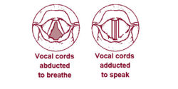
Phonation
Air pressure system
Voice box-open & close the glottis
Abduction is the vocal cords being spread apart (occurs while breathing)
Adduction is the vocal cords coming together (speaking or singing)
Pitch of vibration -determined by the degree of stretch of chords -tightness of chords
-mass of chord’s edges

Slide 25
Acid-Base Balance
Elimination of CO₂
Chemosensors monitor CO₂ & H⁺ ion conc
Control Centers in CNS

Slide 26
References
Guyton & Hall.Text book of Medical Physiology
Ganong’s Review of Medical Physiology
Berne & Levy Physiology
htpp//www.accessmedicine.com

Slide 27
Question 1
Normal volume of air present in dead space of Indian reference man is……..ml:
A) 50
B) 100
C) 150
D) 200

Slide 28
Question 2
Which of the following is the first branching
of the bronchial tree that has gas
exchanging capabilities?
A. Terminal bronchioles. B. Respiratory bronchioles. C. Alveoli D. segmental bronchi E. alveolar ducts.

Slide 29
Question 3
Oxygen and carbon dioxide are exchanged in the lungs and through all cell membranes by ________. A) osmosis B) diffusion C) filtration D) active transport

Slide 30
Question 4
For gas exchange to be efficient, the respiratory membrane must be ________. A) at least 3 micrometers thick B) 0.5 to 1 micrometer thick C) between 5 and 6 micrometers thick D) The thickness of the respiratory membrane is not important in the efficiency of gas exchange.

Slide 31
Question 5
Prominent cells present in the interstitium of the lungs are:
A) Fibroblasts
B) Epithelial
C) Goblet
D) Mucus

Slide 32
Answers
1- C
2- B
3- B
4- B
5- A

